Slide 1





EVENT MANAGEMENT SYSTEM
Team Members: Guide:Mrs.R.Umamaheshwari
Shalini S
Sinduja B
Sowbarnika S
Vijayalakshmi V
Disclaimer: The content is curated for educational purposes only.

Slide 2
OUTLINE
Abstract
Problem Statement
Aims, Objective & Proposed System/Solution
System Design/Architecture
System Development Approach (Technology Used)
Algorithm & Deployment
Conclusion
Future Scope
References
Video of the Project
Notes:
These are the list of chapters that we are going to cover in these foundation codes. Those are chapter one what are AI and ML? chapter 2 applied Python programming in AI, and chapter 3 is exploratory data analysis for ML.

Slide 3
Abstract
This project deals with the Event-management system that is implemented in a website and is capable of providing all the important access to both the student and faculty in an instituition. It helps faculty to create or delete an event. The student is able to view the created events and register for the same. The student can upload the certificate of the registered event and faculty can view the student report and download the student certificates in the system. This project will minimize office-work and man power hence providing a untroubled way of managing events in a college. The reason of making this website is to digitalize the techniques involved in hosting activities, additionally it can be accessed anytime and anywhere.

Slide 4


Problem Statement
It is difficult to keep track of events happening in an organization, staying updated and reading out reports of individual event is puzzling.It also includes numerous paper works and cooperation of many team members which may be hard to manage. Apart from these keeping track of events and registrations is also difficult.

Slide 5

Aim and Objective
The goal of this application is to develop a system that correctly manages all the information related to the numerous occasions that takes place in an institution. The purpose is to keep a centralized database of all occasion associated statistics. The goal is to assist numerous features and techniques essential to control the information correctly.

Slide 6
Proposed Solution
It is difficult to keep track of events happening in an organization, staying updated, allowed to give feedback and reading out reports of individual event is puzzling. Hence this Event Management System will allow an institute to manage all of this task in one central portal. This project is an Event management portal that is implemented on a website. This challenge offers characteristic of remotely developing, removing, statistics retrieval, modifying of events and many different functions. This project is efficient in providing all the important access to both the faculty and student related to a particular event.

Slide 7
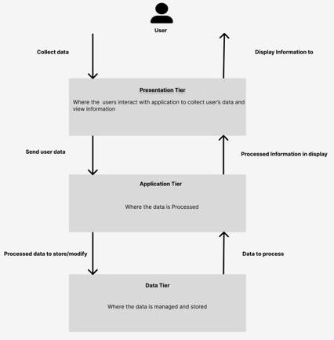
System Architecture

Slide 8
System Deployment Approach
This Event Management System is developed using PHP, MySql, Bootstrap, Javascript, and jQuery. This project specially developed for an institute. In this Project,
The faculty and students can signup and login into their account.
The faculty can create an event and student can apply to it. After that event completion, the student has to upload the certificate in their account using their login id and password.
The faculty can see the students event report in their account.
If the faculty and student organized or participated any event then they can register by themselves and can see their report.

Slide 9
Algorithm & Deployment
User Authentication:
Secure password hashing is applied during student and faculty registration and login processes.
Event Application Handling:
When a user applies for an event, the system validates and stores the application details.
Server Setup:
Choose a suitable web server (e.g., Apache) and configure it to handle PHP requests. Ensure PHP and MySQL are installed on the server.
Database Setup:
Execute SQL scripts to create the necessary tables and relationships.
Set up user accounts and permissions for database access.
Backend Deployment:
Upload PHP files to the server.
Configure server-side scripts to interact with the MySQL database.
Frontend Deployment:
Upload HTML, CSS, JS, and jQuery files to the server.

Slide 10
Conclusion
In this ‘Event Management System’, project we tried to effectively introduce the idea of event management systems which already exist. We then introduced the concept of on-line event management systems which helps in managing the events through on-line for an institution.The developed project helps in search of the events, generating and retrieving the information for the respected requests.This project can be further polished and extended by introducing new and more innovative features.

Slide 11
Future Scope
This web based application system can be implemented in hotels, clubs for booking events. The system can also be used as software to promote the entire booking places. The user gets all the resources at a single place instead of wondering round for these. This system is effective and saves time and cost of the user.

Slide 12
Reference
Paper on ‘Study on Event Management Applications’ by International Journal of Innovative Science and Research Technology Volume 2, Issue 4, April– 2017
Prof. Khalil Pinjari and Khan Nur, “Smart Event Management System”.
Paper on Volunteer tools by IEEE Paper on ‘COLLEGE EVENT MANAGEMENT SYSTEM’ International journal of Innovative Science and Research Technology Volume: 07 Issue: 03 | Mar 2020
Notes:
Reference
These are the references for this session.
‹#›

Slide 13
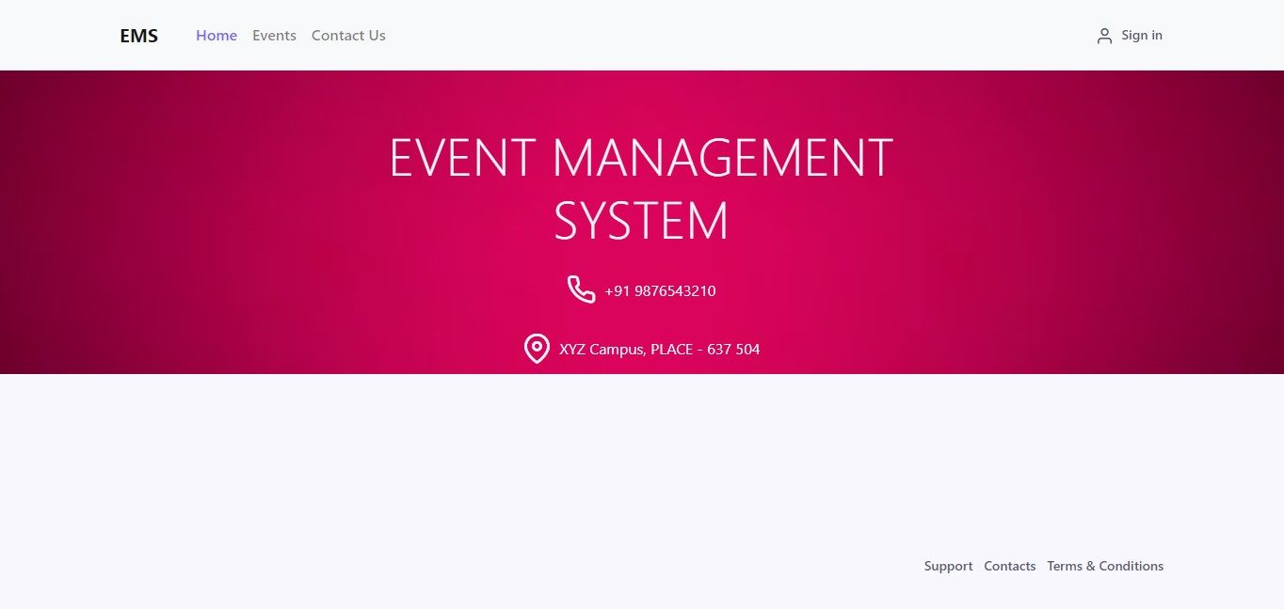
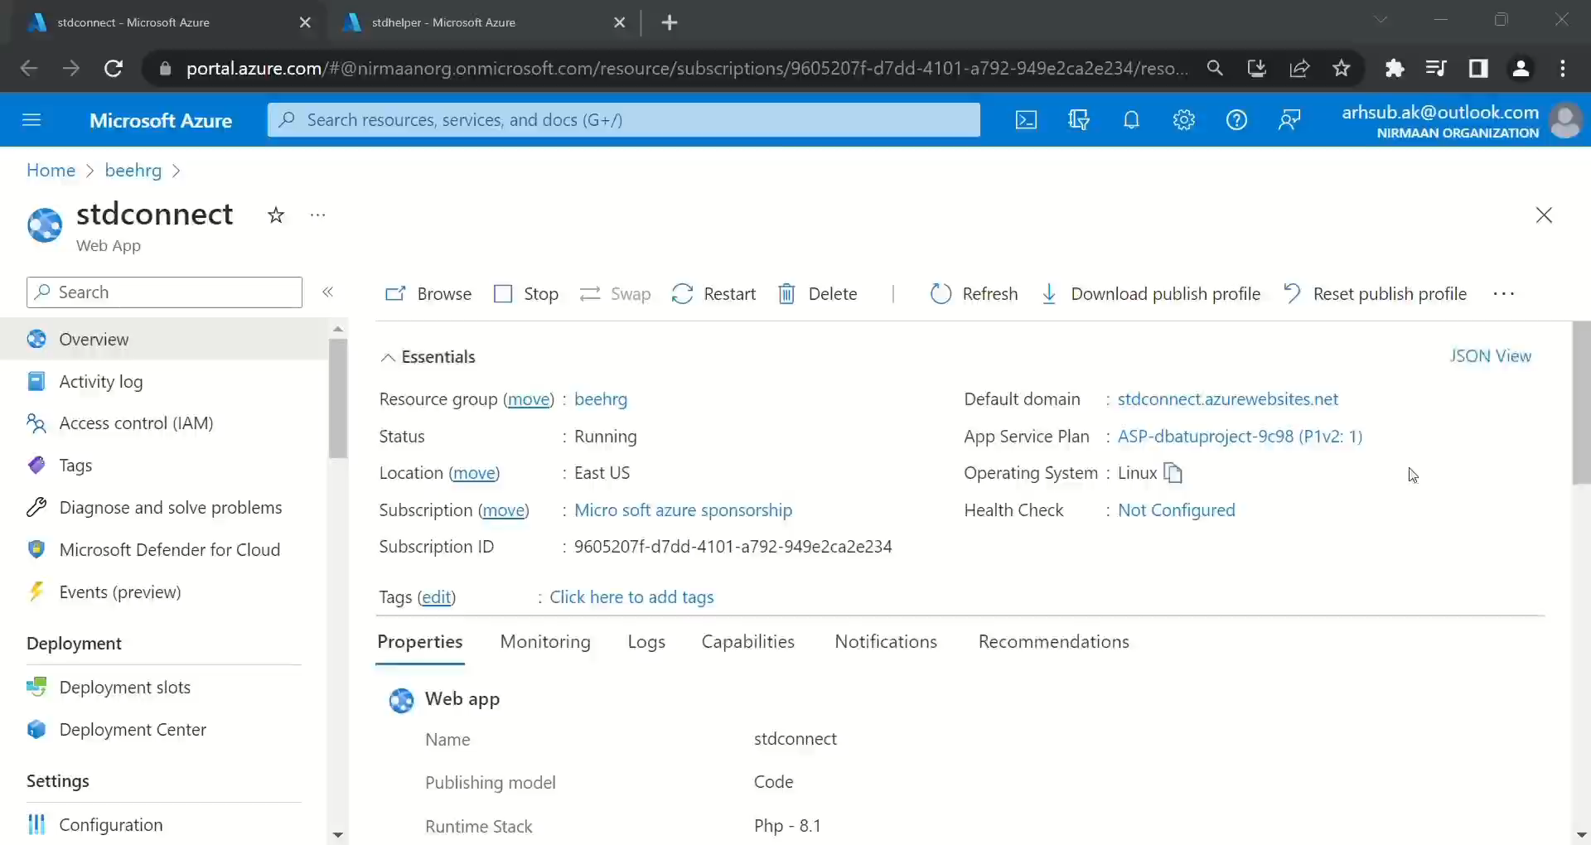

Slide 14
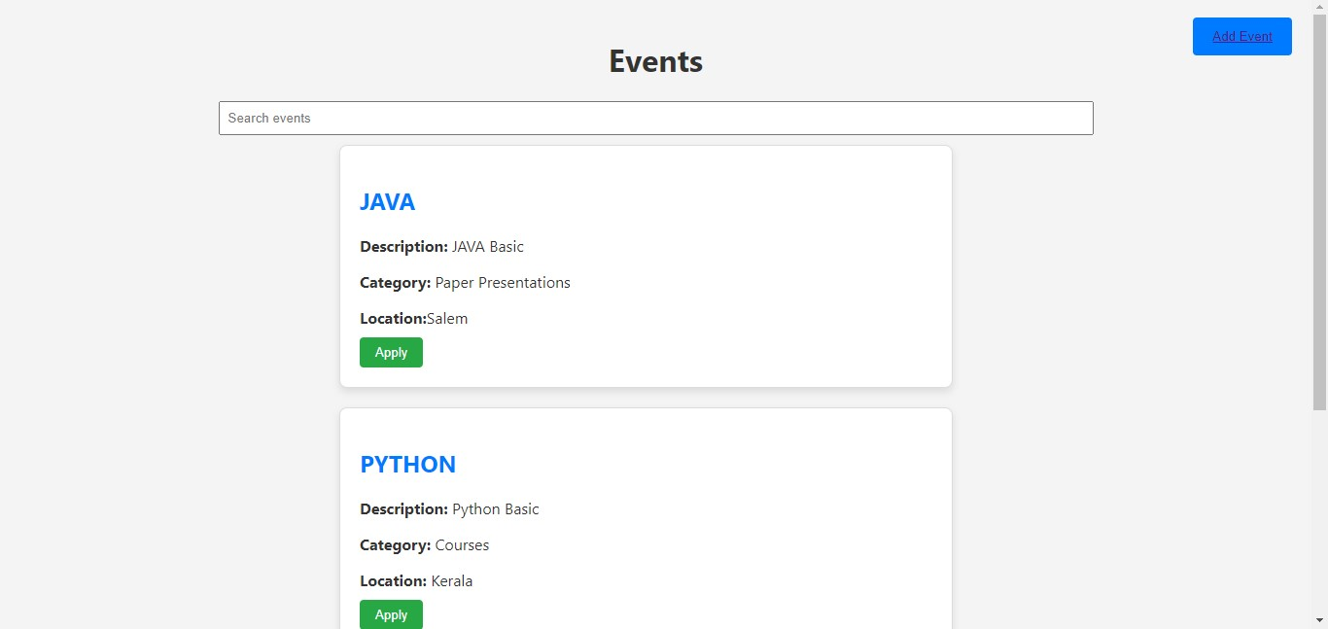
Event Management System

Slide 15
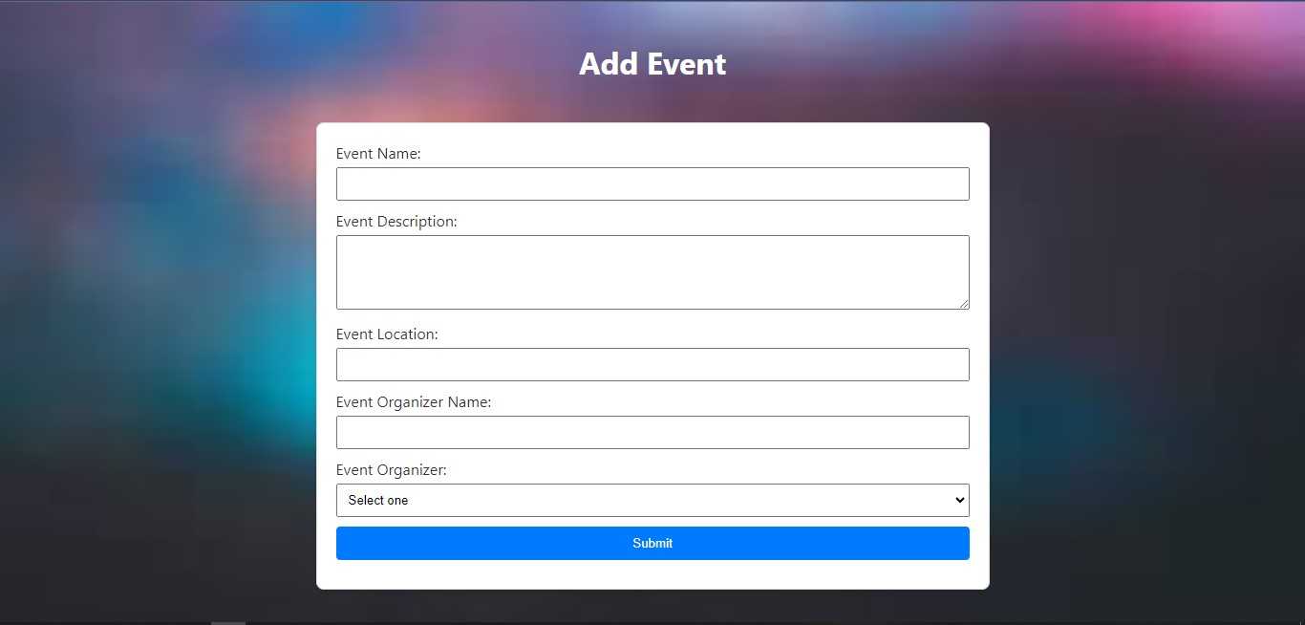
Event Management System

Slide 16
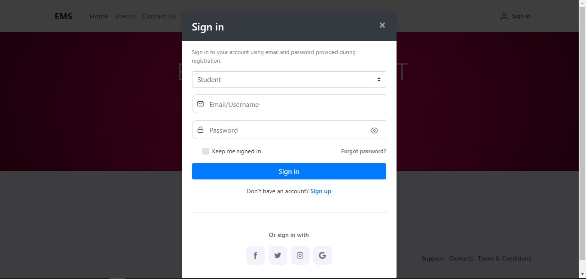

Slide 17
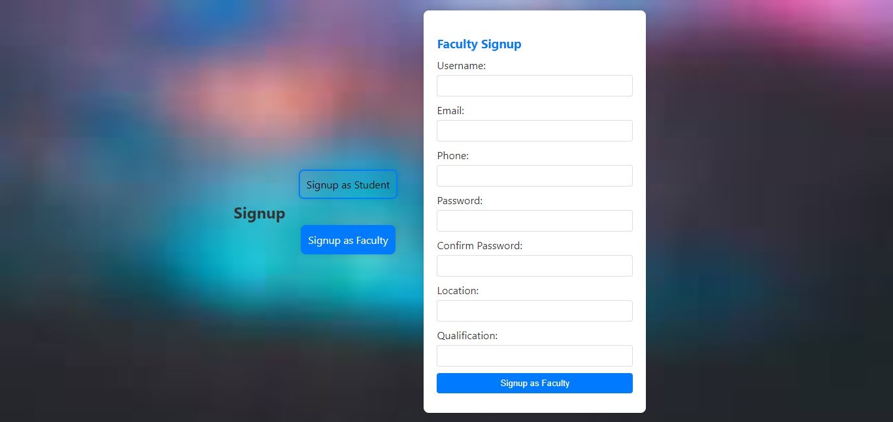
Event Management System

Slide 18
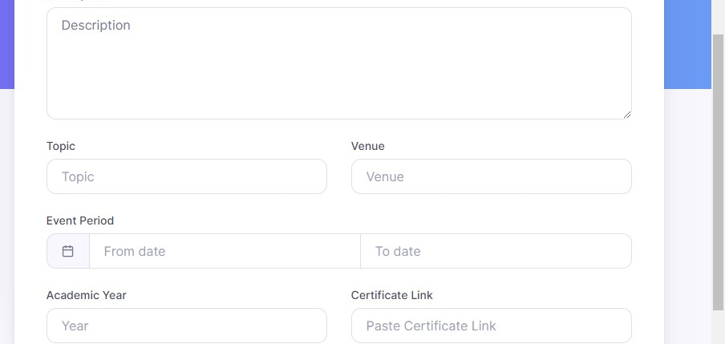
Event Management System

Slide 19
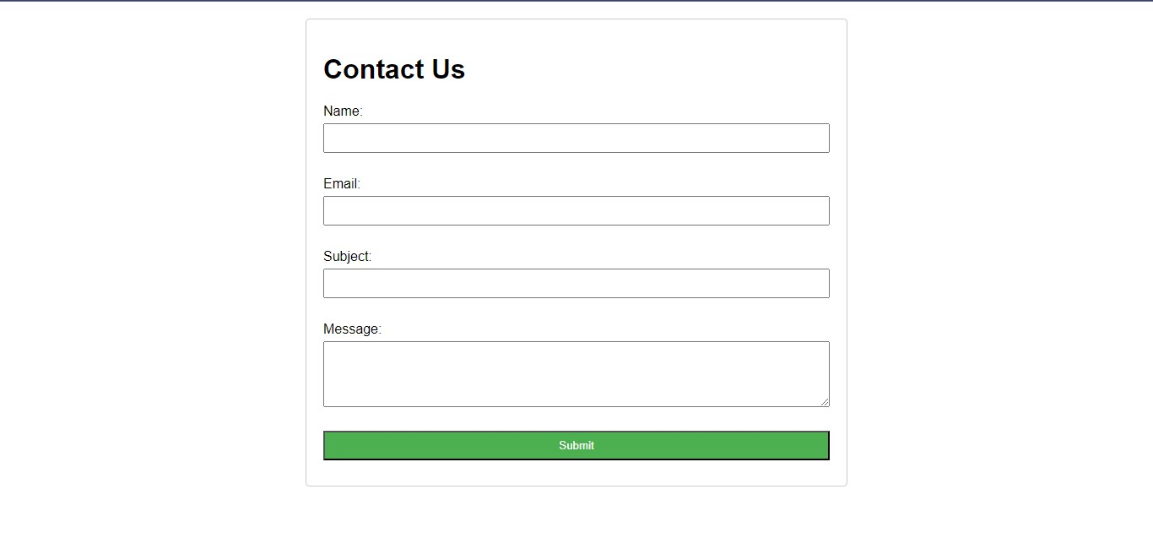

Slide 20
Links
Video link: https://drive.google.com/file/d/1xnk0TZ-JF67AI9eINAga1RLy-bp8n6RT/view?usp=sharing&t=2
Github link: https://github.com/vsviji/EMS/tree/main

Slide 21
Thank you!
Notes:
thank you very much for joining this PPT, keep learning.
‹#›

